Slide 1

RUNGTA COLLEGE OF DENTAL SCIENCES & RESEARCH
CHILD ABUSE AND NEGLECT
DEPARTMENT OF PEDODONTICS AND PREVENTIVE DENTISTRY

Slide 2
SPECIFIC LEARNING OBJECTIVES
Core areas | Domain
Introduction Historical background Definition Characteristic of child abuse | Child neglect Role of pedodontics in child abuse and negligence

Slide 3
CATEGORY
MUST TO KNOW
NICE TO KNOW
Physical child abuse
DESIRE TO KNOW
Role of pedodontic and child abuse and negligence
Definition
Characteristic of child abuse
Child sexual abuse

Slide 4
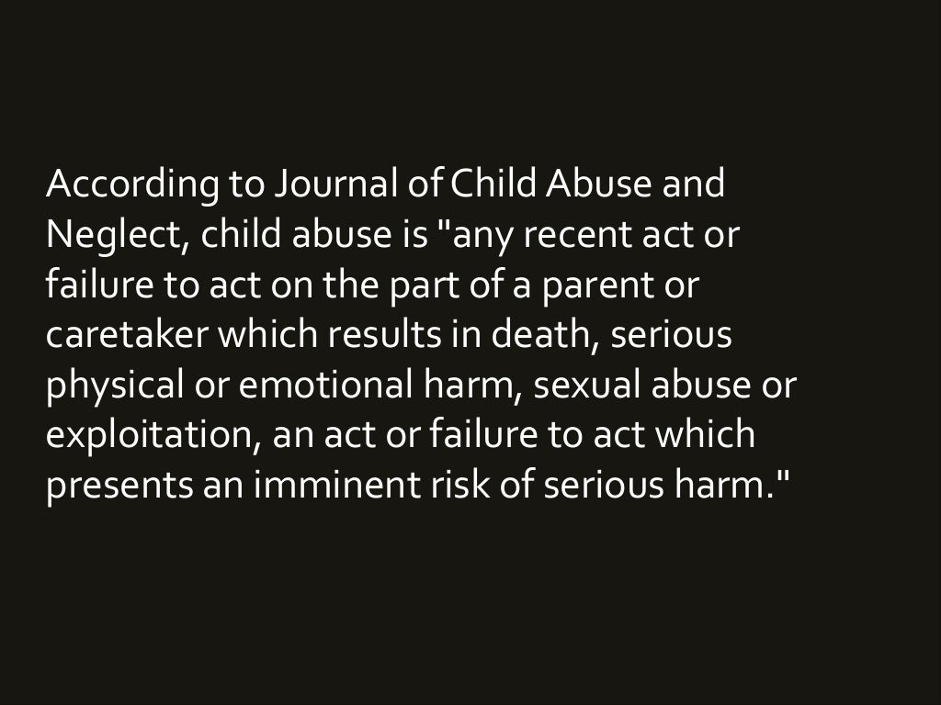

Slide 5
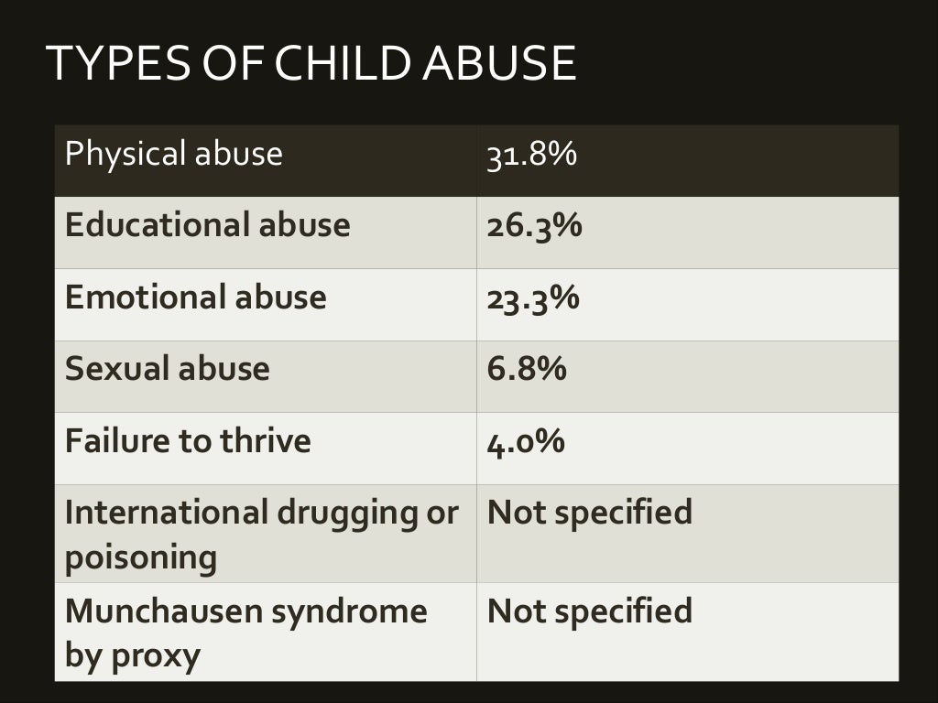

Slide 6
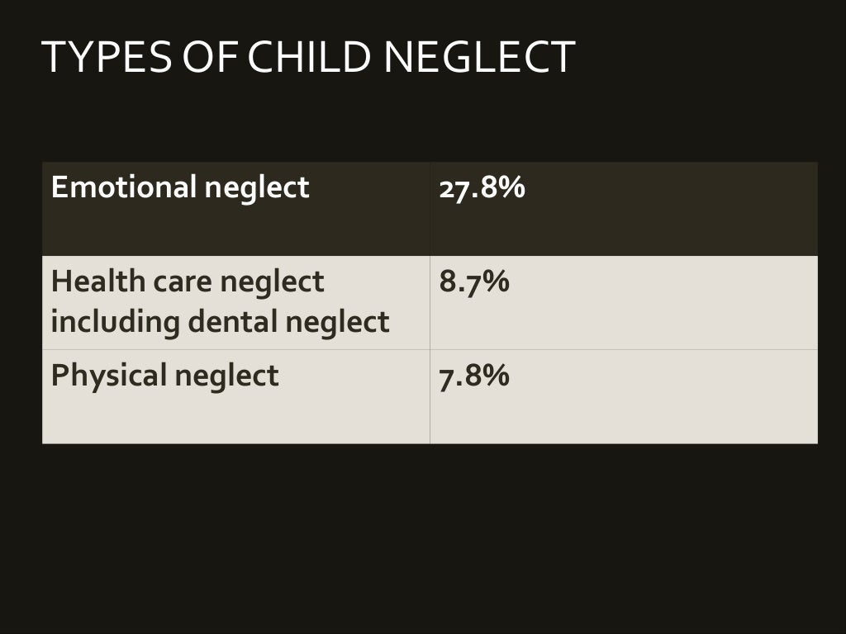

Slide 7
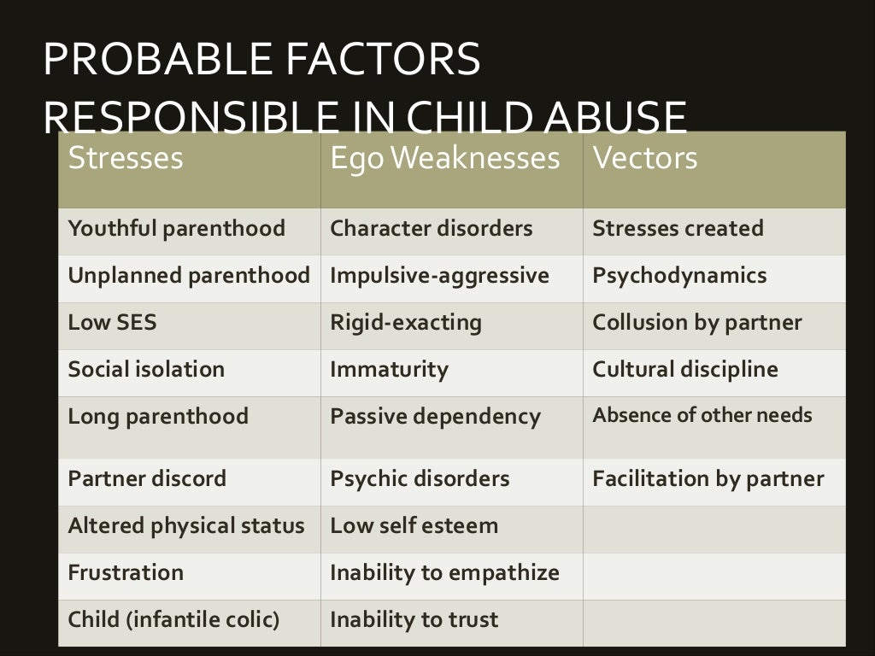

Slide 8
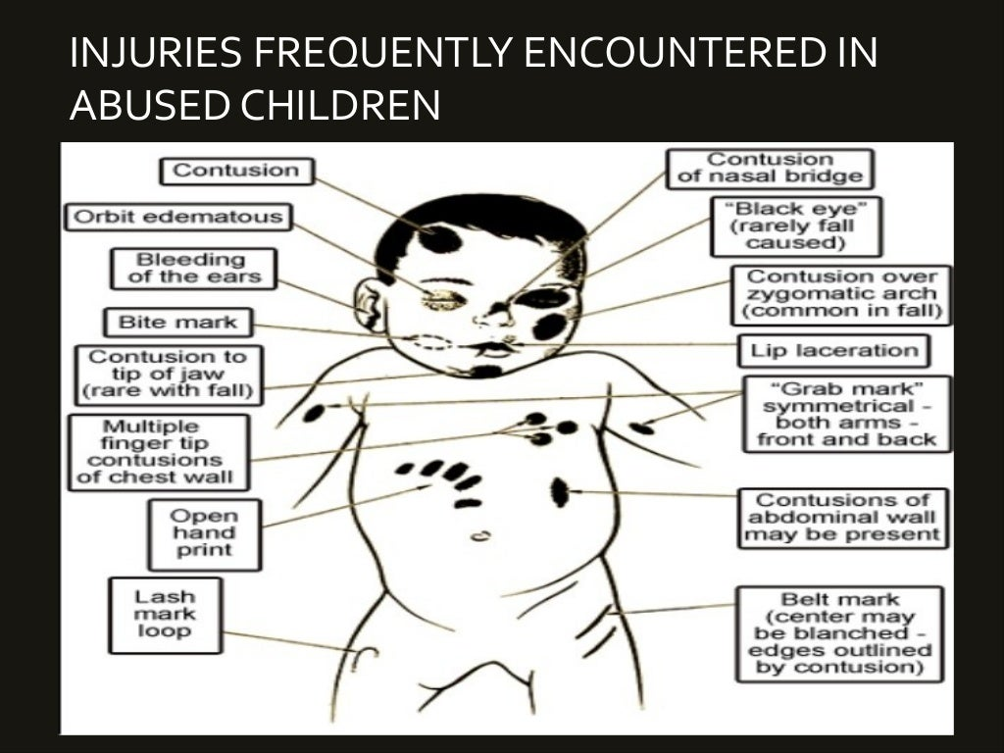

Slide 9
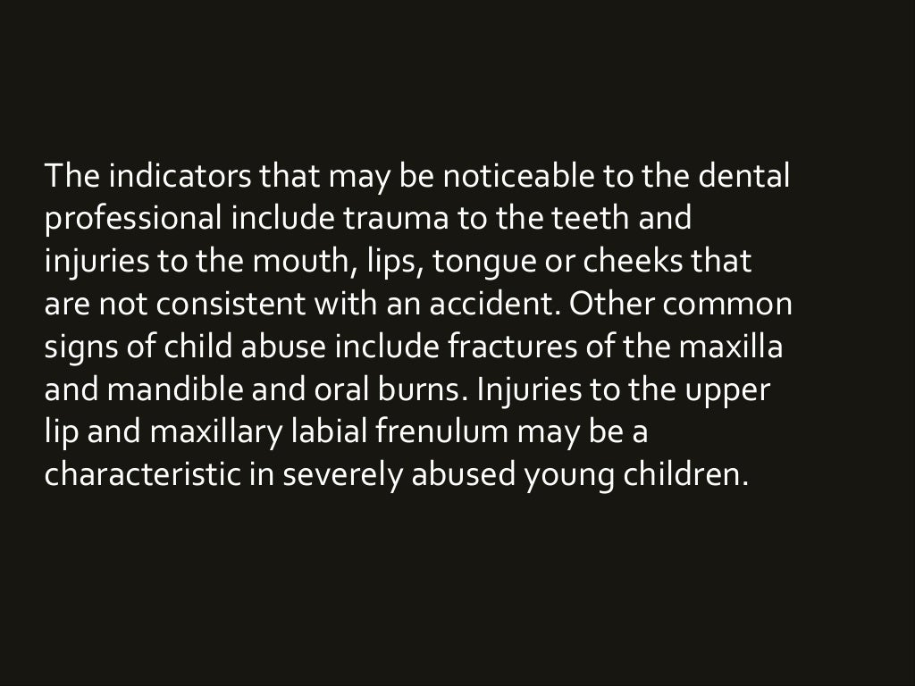

Slide 10
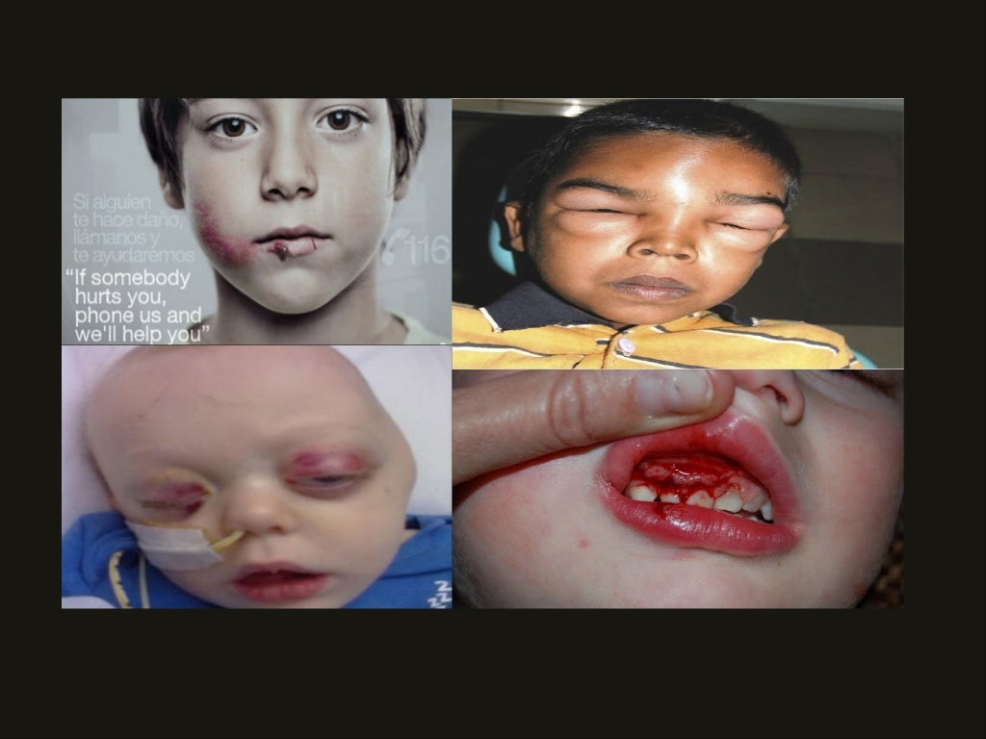

Slide 11
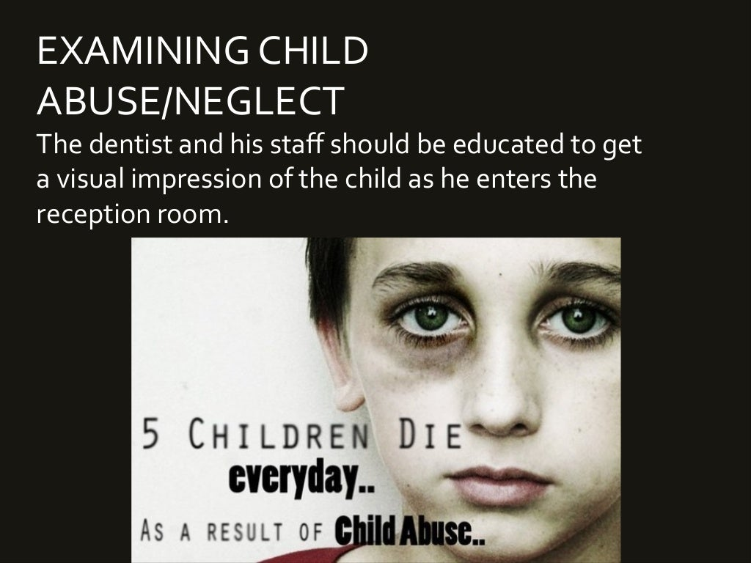

Slide 12
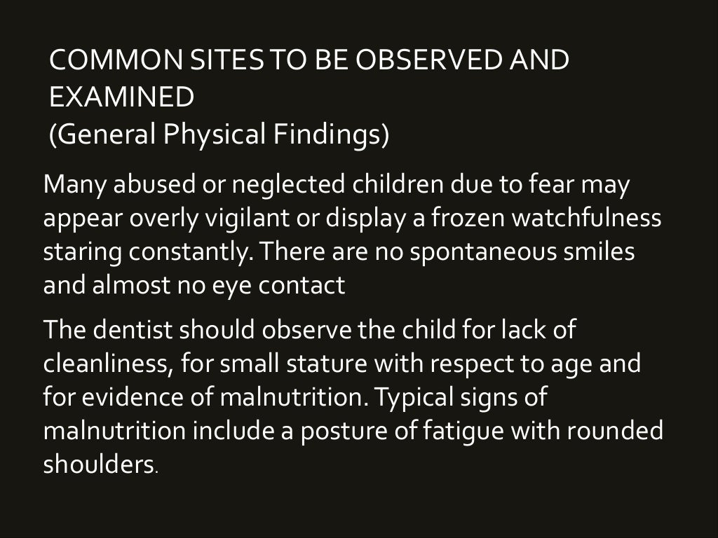

Slide 13
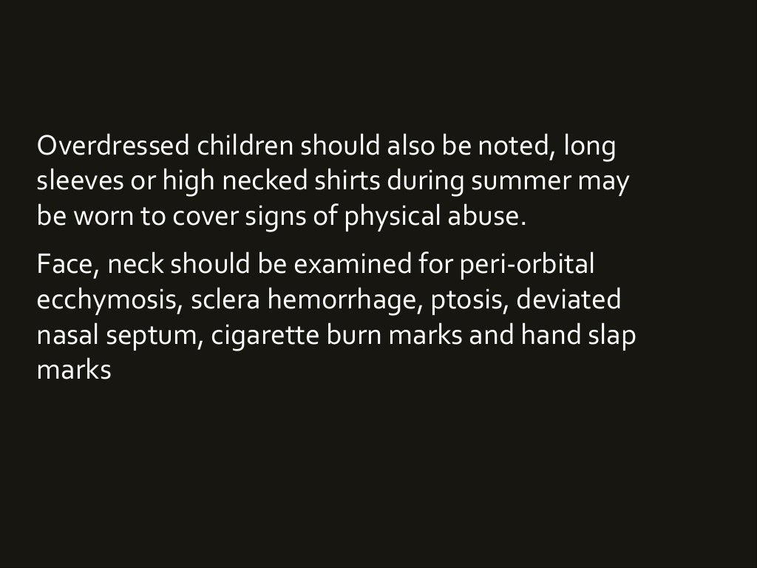

Slide 14
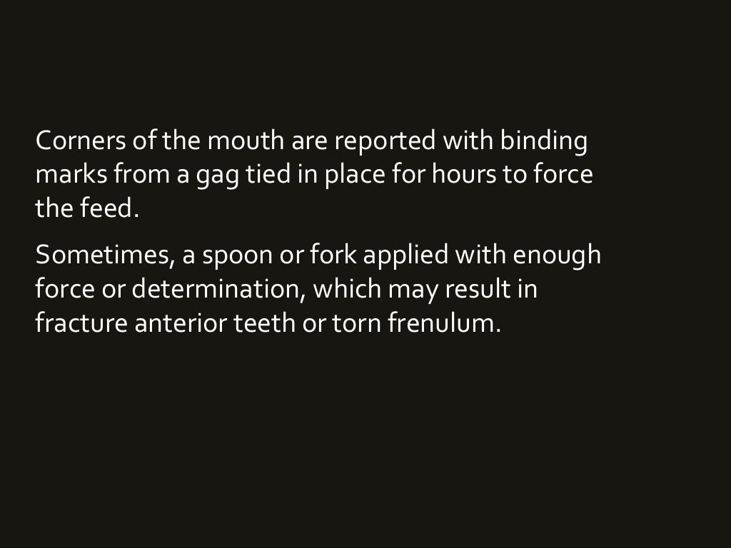

Slide 15
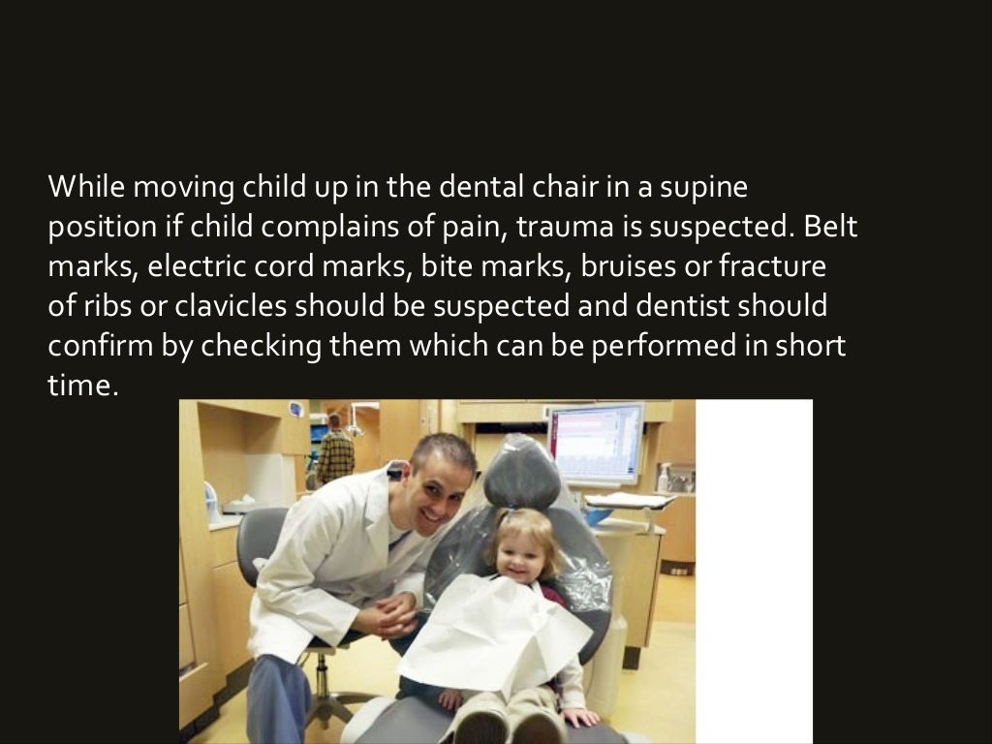

Slide 16
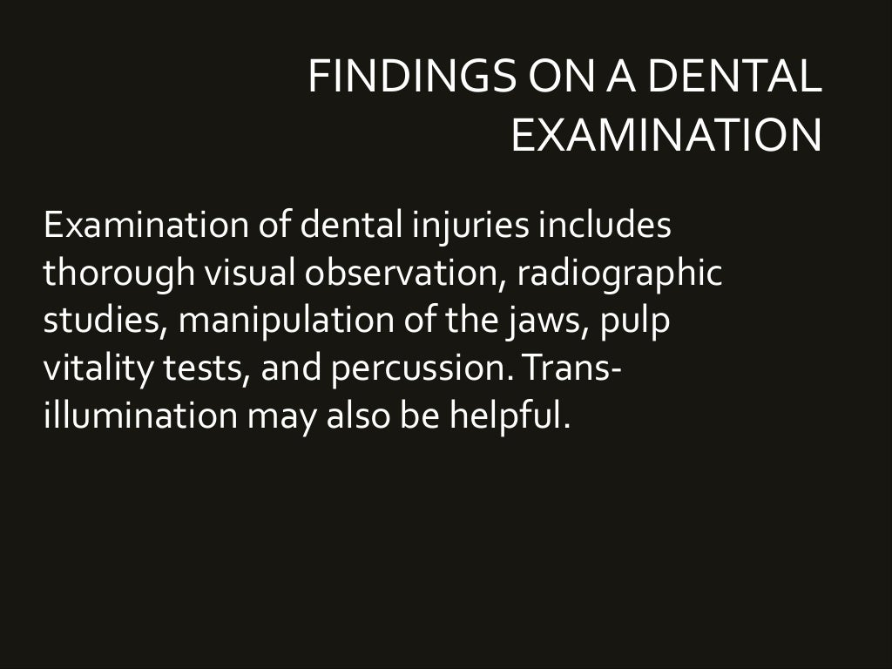

Slide 17
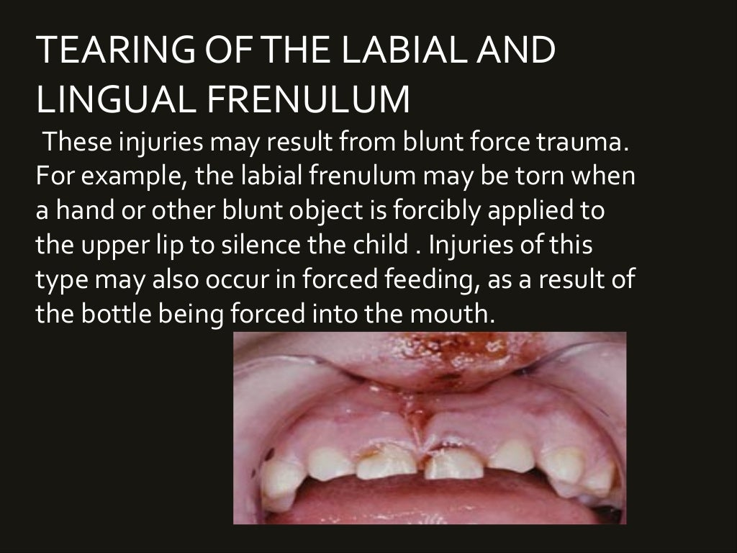

Slide 18
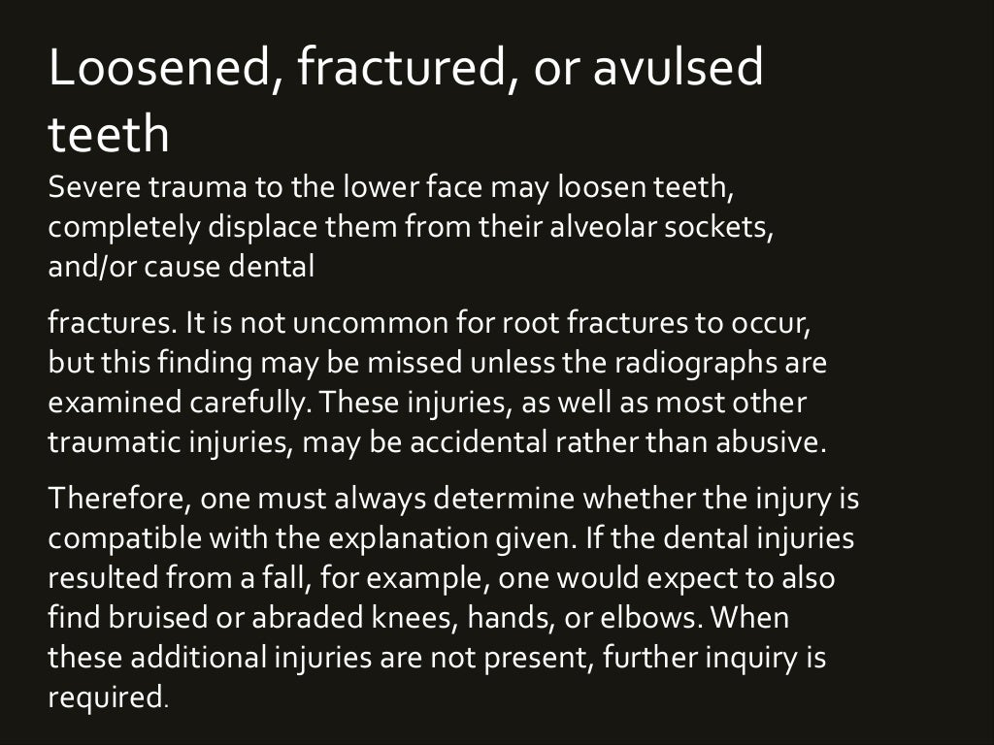

Slide 19
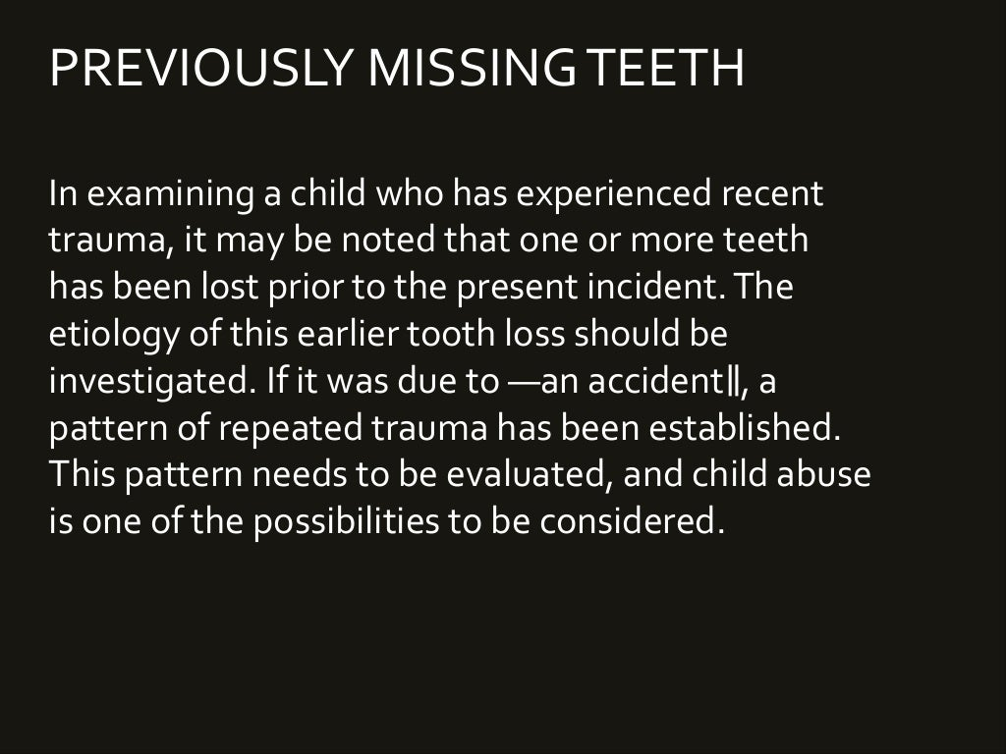

Slide 20
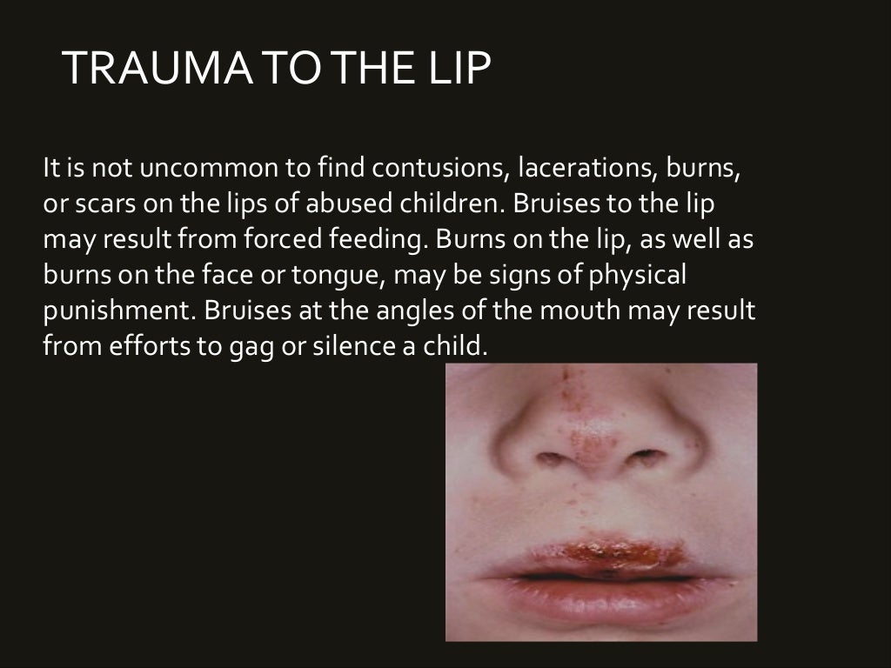

Slide 21
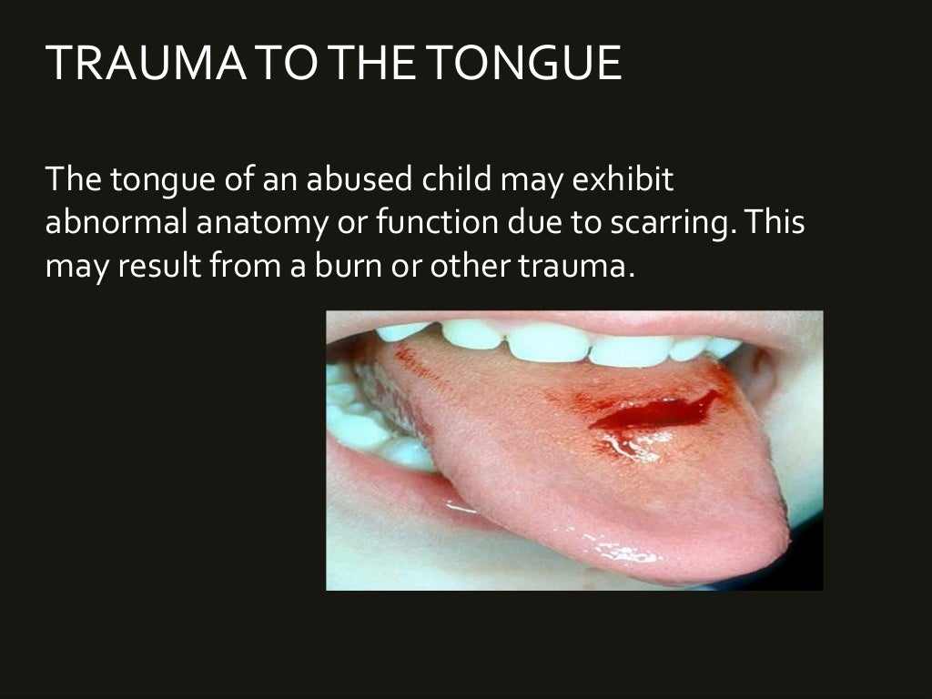

Slide 22
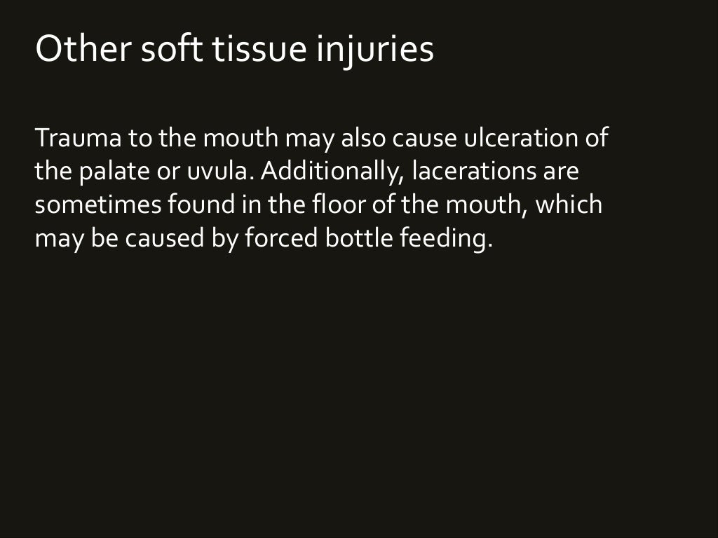

Slide 23
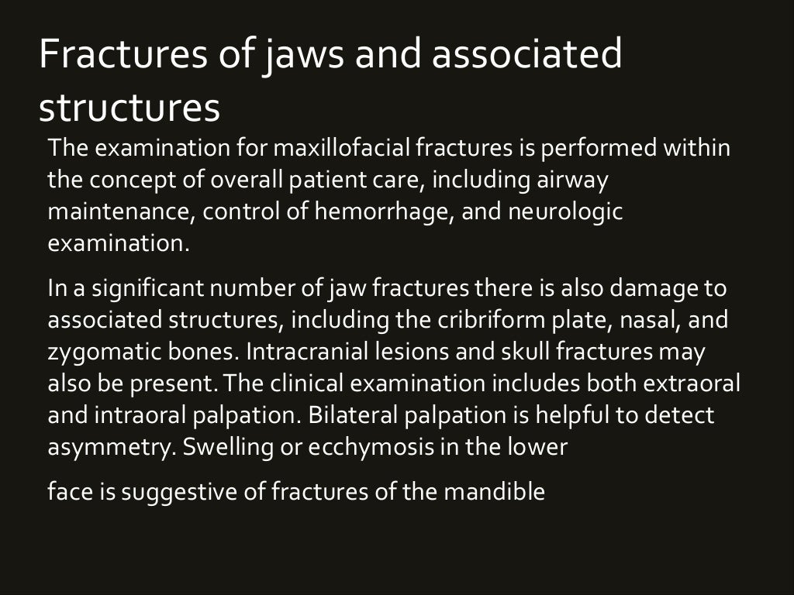

Slide 24
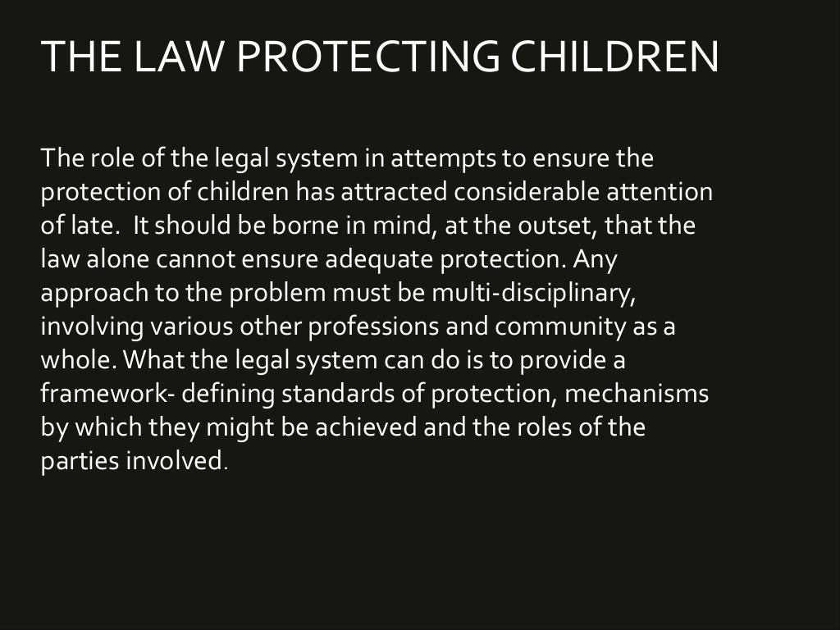

Slide 25
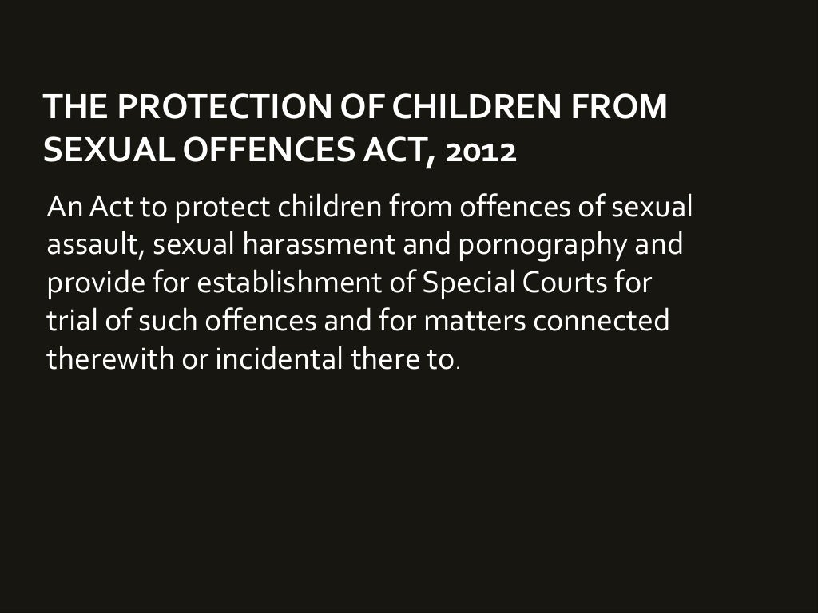

Slide 26
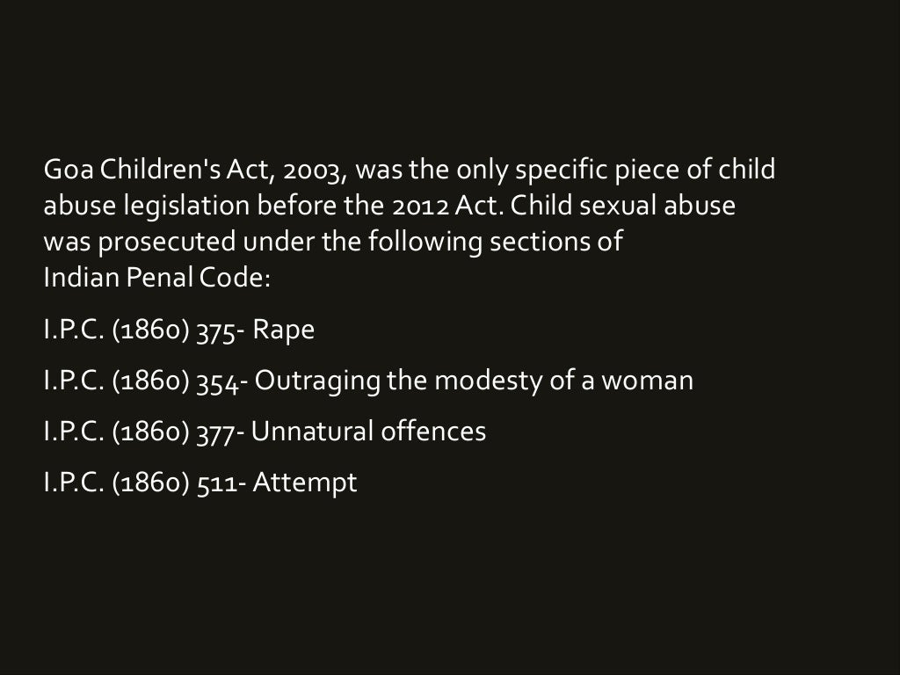

Slide 27
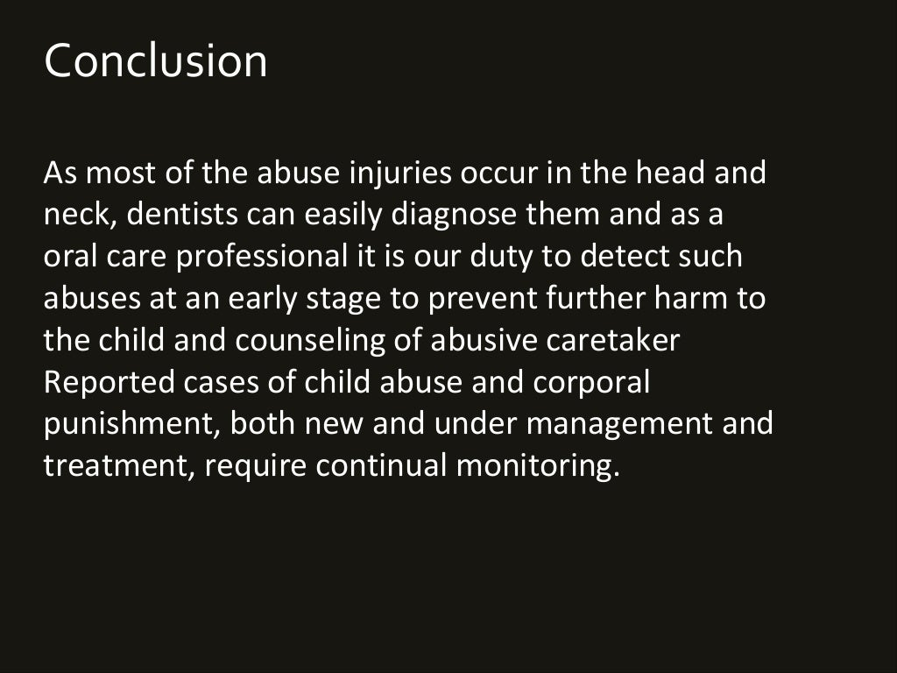

Slide 28
TAKE HOME MESSEGE
Child abuse is defined as the non accidental physical injury, minimal or fatal children by persons caring for them. It is an overact of commission of a care taker-physical, emotional, sexual.
Dental neglect is the failure of a parent or a guardian to seek frequent for visually untreated caries, oral infection, pain, or failure of the parent or guardian to follow through with the treatment once informed earlier.

Slide 29
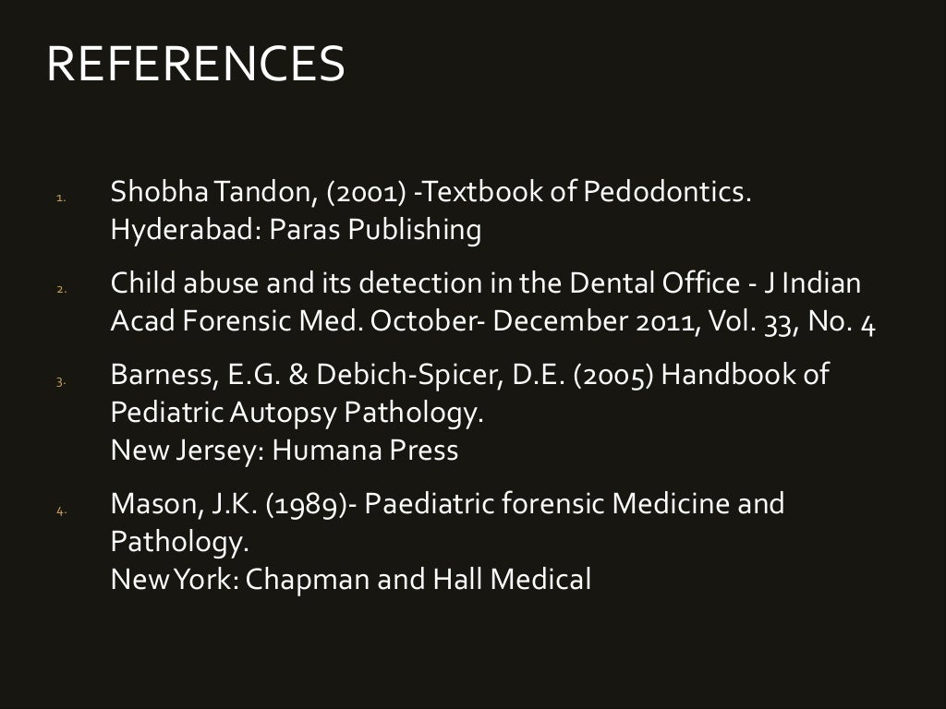

Slide 30


